Slide 1
SELECT COUNT(*) FROM (SELECT NAME FROM PG18.NEWFEATURES UNION SELECT NAME FROM PG18.NEWENHANCEMENTS) AS COMBINED COUNT;
Who wants to Win…

Slide 2
Preserved Planner Stats
Native Oauth 2.0
Async I/O
UUiD V7 support
Postgres 18’s New Features
Temporal constraints
Returning with OLD / NEW
B-tree Skip Scan
Virtually Generated Cols

Slide 3
Shemal Gandhi DBA | Cloud Engineer | Tech Lead
Beyond Async I/O : Postgres 18’s Hidden Gems

Slide 4
pg_buffercache_evict_all();

Slide 5
Before Postgres 18, only way to empty shared_buffers was RESTART
Part of pg_buffercache extension
Super user access required
Only unpinned buffers are evicted
NOT for Production.
sql
postgres=CREATE EXTENSION pg_buffercache;
postgres=SELECT * from pg_buffercache_evict_all();
buffers_evicted | buffers_flushed
14328 | 142

Slide 6
How it helps
Replicate “Cold Cache” for new queries / DB restart
Testing checkpoint behavior
Double Buffering : shared_buffers vs OS Cache analysis
sql
postgres=EXPLAIN (ANALYZE, BUFFERS) SELECT ...;
postgres=SELECT * FROM pg_buffercache_evict_all();
postgres=EXPLAIN (ANALYZE, BUFFERS) SELECT ...;

Slide 7
NOT enforced

Slide 8
Pg18 brings Postgres in line with SQL standard 2023 :- Constraints have to be ENFORCED / NOT ENFORCED
Historically Postgres would act as a gate keeper for every constraint created automatically checking every write operation
Allows us to declare a CHECK or FOREIGN KEY constraint without enforcing it on every writes
Constraint exists in the DB metadata but DMLs are NOT rejected when they violate it
Important distinction :
NOT VALID = "trust new rows, audit old rows later" → temporal/migration tool
NOT ENFORCED = "don't check anything, anytime" → documentation/off-switch tool
Re-enforcing constraint currently limited to FOREGIN KEY constraint only at the moment

Slide 9
How it helps
Large legacy systems with dirty data
High ingest pipelines where write costs matter
Federated or externally controlled data stored in Postgres
Gradual migration from App enforced rules to DB enforced rules

Slide 10
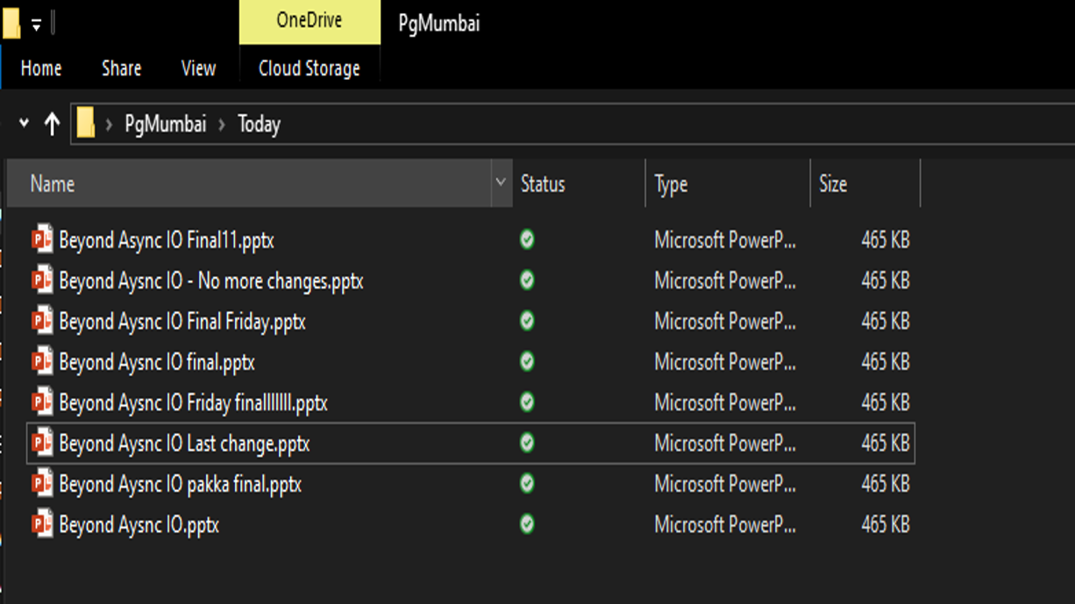

Slide 11
autovacuum_vacuum_max_threshold

Slide 12
Hard ceiling on dead tuples being accumulated in a table
Runs Independently of the “SCALE FACTOR” maths.
Classic autovacuum maths: autovacuum_vacuum_threshold + (autovacuum_vacuum_scale_factor X table_size)
Eg: With default settings (threshold 50, scale factor 0.2), a 10 million row table needs over 2 million dead tuples before autovacuum runs.
Default value at 100,000,000 tuples. Can be set at table level as well.
sql
autovaccum_vacuum_max_threshold=100000000 –default in postgresql.conf
ALTER TABLE user_session SET (autovacuum_vacuum_max_threshold = 100000);

Slide 13
How it helps
Caping bloat on very large high churn tables
Targeting specific hot tables
Cloud Managed Postgres deployments tuning
Simplified vacuum monitoring ; looking at dead tuples you’ll know when vacuum will happen on a table!

Slide 14
extension_control_path

Slide 15
Files .control and .sql tells Postgres what an extension is, its version and how to build its functions / tables.
Usually stored in installation’s SHAREDIR/extension location
For immutable env like CloudNativePg, this path is READ ONLY.
Meaning you have to rebuild the base image in Containers / Kubernetes every time we add a new extension
extention_control_path allows custom path where Postgres can look for .control & .sql files
CloudNativePg can dynamically inject extensions at container startup
Works in tandem with another GUC parameter : dynamic_library_path
sql
extention_control_path = ‘/extensions/mycustomplugins/share:$system’
dynamic_library_path = ‘/extensions/mycustomplugins/lib:$libdir’

Slide 16
How it helps
Kubernetes / CloudNativePg : Dynamic extension installation without base image rebuilds
Security : Keep the core gold image separate
Multi-tenant model : Per project extension isolation
macOS : Restricted environment installations

Slide 17
To log or not to log, What to Log , What NOT to Log is the question.
William Postgresphere said:

Slide 18
log_connections

Slide 19
Prior to Postgres18, this meant large amount of noise on a busy system
Upgraded from a simple Boolean (ON / OFF) to a List.
Now we can choose which part of connection needs to be logged.
Captures these stages of the connection which can be logged :
Receipt (Connection received)
Authentication (Client authorized)
Authorization (Connection authorized)
sql
log_connections = 'receipt, authentication, authorization’ | Logs all
log_connections = 'authorization’ | Audit successful logins
log_connections = ‘’ | Turn OFF ALL logging

Slide 20
How it helps
Reducing LOG noise on high churn systems
Security auditing : Targeting “authorization” stage only
Diagnostics of slow connections : Network level (receipt delay ) vs auth related (slow LDAP / Kerberos) vs authorization (privilege / role related)
Pair this with log_disconnections to get more info about the entire duration of the session.

Slide 21
Something extra:
pg_upgrade swap mode
pg_overexplain
pg_stat_io
log_lock_failures

Slide 22

Shemal Gandhi
Thank You!!!

